Slide 1
Online Anomalous Trajectory Detection with Deep Generative Sequence Modeling

Slide 2
PROBLEM FORMULATION

Slide 3
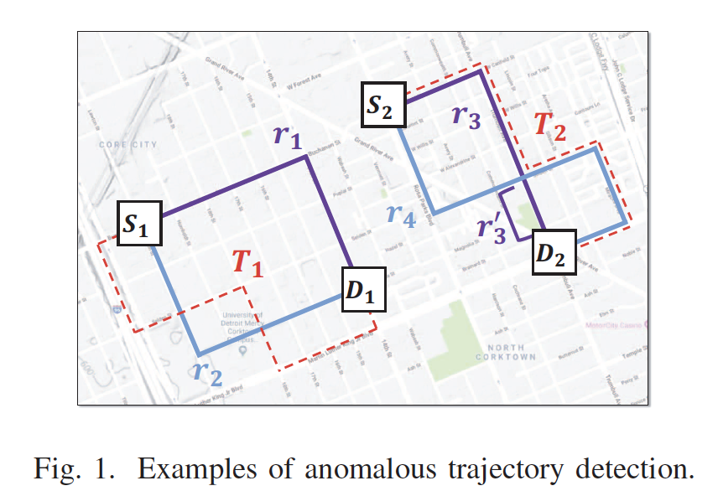
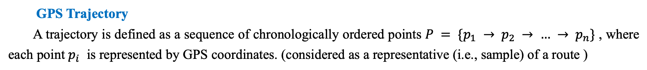
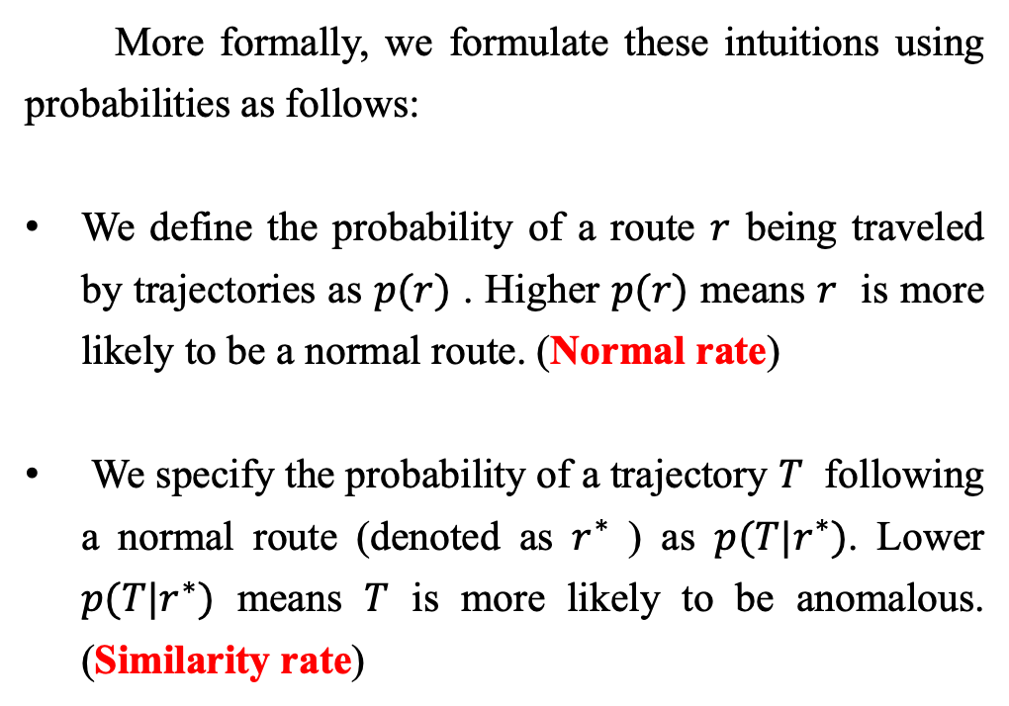
PROBLEM FORMULATION
GPS Trajectory
A trajectory is defined as a sequence of chronologically ordered points $P = \{p_{1} → p_{2} → … → p_{n}\}$ , where each point $p_{i}$ is represented by GPS coordinates. (considered as a representative (i.e., sample) of a route )
More formally, we formulate these intuitions using probabilities as follows:
We define the probability of a route $r$ being traveled by trajectories as $p(r)$ . Higher $p(r)$ means $r$ is more likely to be a normal route. (Normal rate)
We specify the probability of a trajectory $T$ following a normal route (denoted as $r^{∗}$ ) as $p(T|r^{∗})$. Lower $p(T|r^{∗})$ means $T$ is more likely to be anomalous. (Similarity rate)

Slide 4
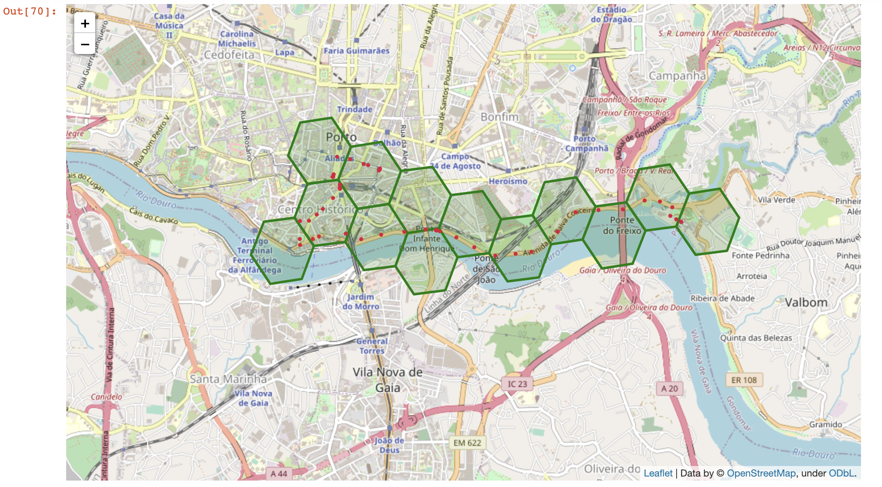
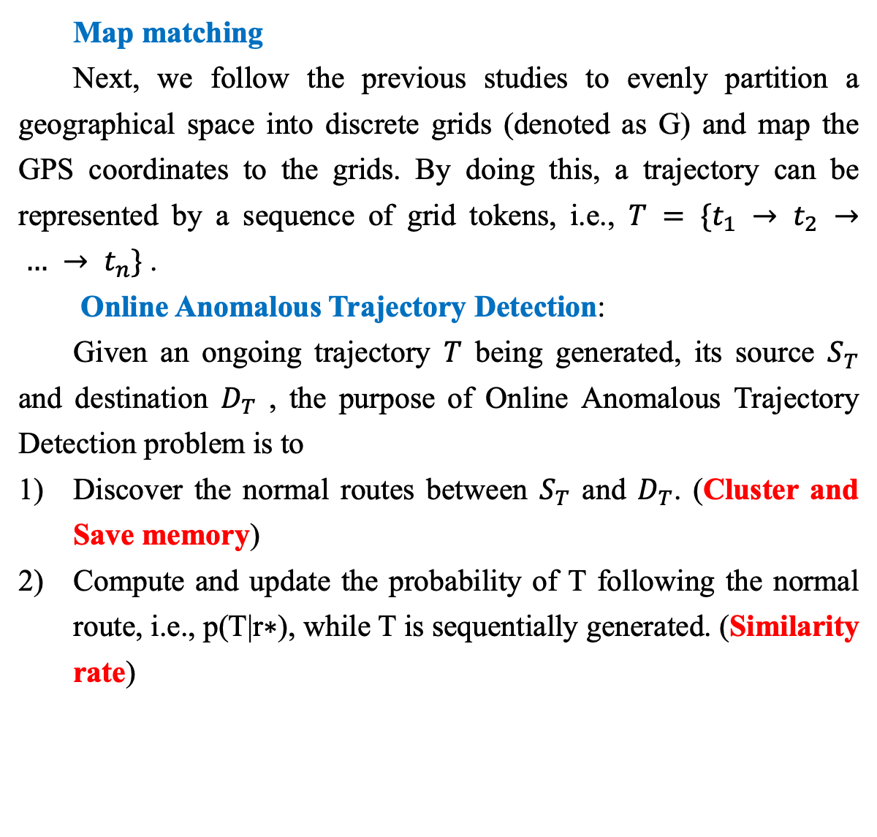
PROBLEM FORMULATION
Map matching
Next, we follow the previous studies to evenly partition a geographical space into discrete grids (denoted as G) and map the GPS coordinates to the grids. By doing this, a trajectory can be represented by a sequence of grid tokens, i.e., $T = \{t_{1} → t_{2} → … → t_{n}\}$.
Online Anomalous Trajectory Detection:
Given an ongoing trajectory $T$ being generated, its source $S_{T}$ and destination $D_{T}$ , the purpose of Online Anomalous Trajectory Detection problem is to
Discover the normal routes between $S_{T}$ and $D_{T}$. (Cluster and Save memory)
Compute and update the probability of T following the normal route, i.e., p(T|r∗), while T is sequentially generated. (Similarity rate)

Slide 5
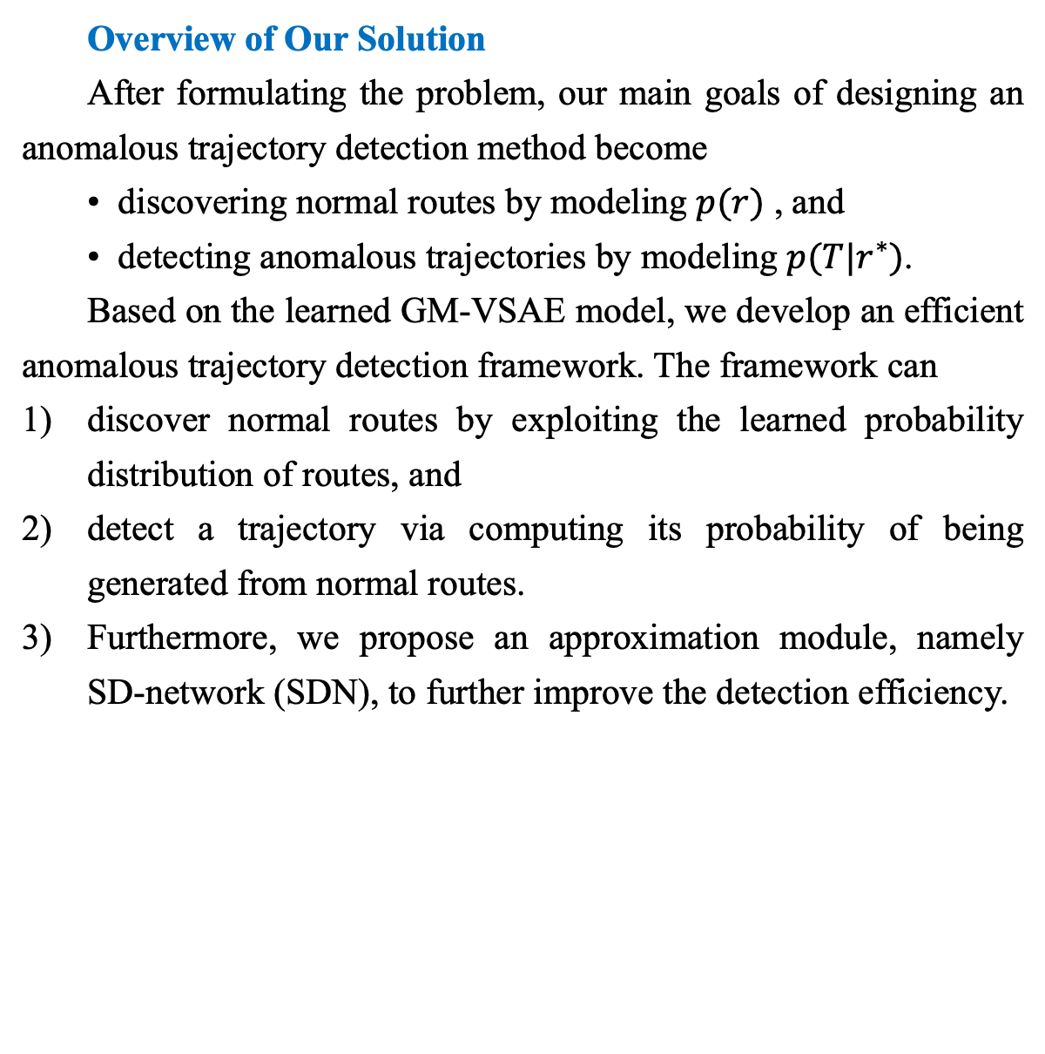
PROBLEM FORMULATION
Overview of Our Solution
After formulating the problem, our main goals of designing an anomalous trajectory detection method become
• discovering normal routes by modeling $p(r)$ , and
• detecting anomalous trajectories by modeling $p(T|r^{∗})$.
Based on the learned GM-VSAE model, we develop an efficient anomalous trajectory detection framework. The framework can
discover normal routes by exploiting the learned probability distribution of routes, and
detect a trajectory via computing its probability of being generated from normal routes.
Furthermore, we propose an approximation module, namely SD-network (SDN), to further improve the detection efficiency.

Slide 6
GAUSSIAN MIXTURE VARIATIONAL SEQUENCE AUTOENCODER

Slide 7
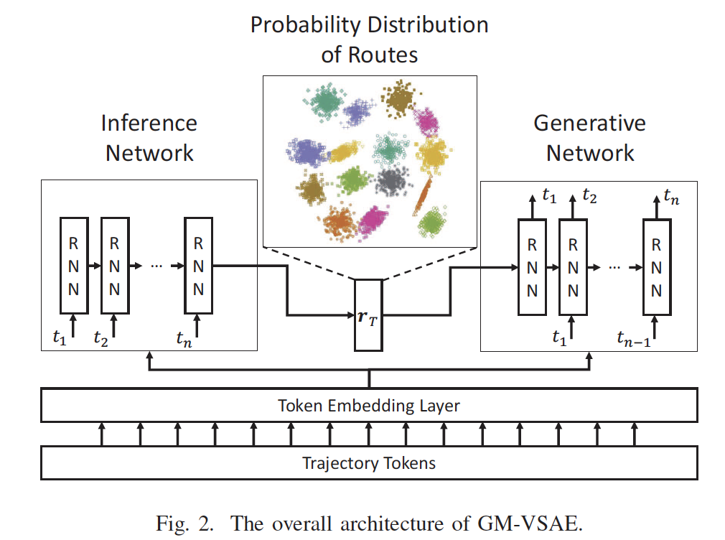
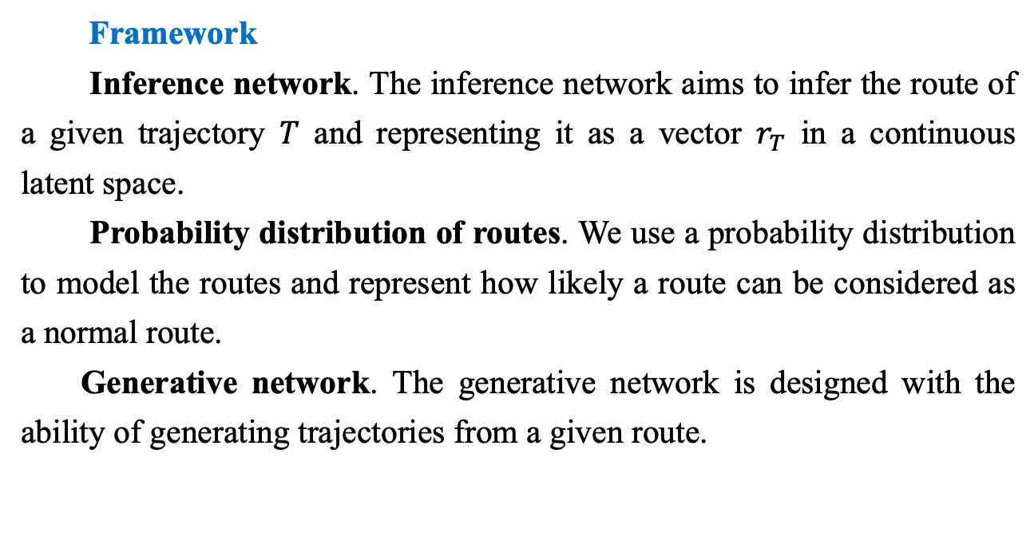
GMVSA
Framework
Inference network. The inference network aims to infer the route of a given trajectory $T$ and representing it as a vector $r_{T}$ in a continuous latent space.
Probability distribution of routes. We use a probability distribution to model the routes and represent how likely a route can be considered as a normal route.
Generative network. The generative network is designed with the ability of generating trajectories from a given route.
For GM-VSAE, our main goal is to jointly train these components, such that
the probability distribution can well characterize the routes of trajectories in the latent space, and
the generative network can generate trajectories from latent routes.
The probability distribution of routes and the generative network will be subsequently used for online anomalous trajectory detection in Section V.

Slide 8
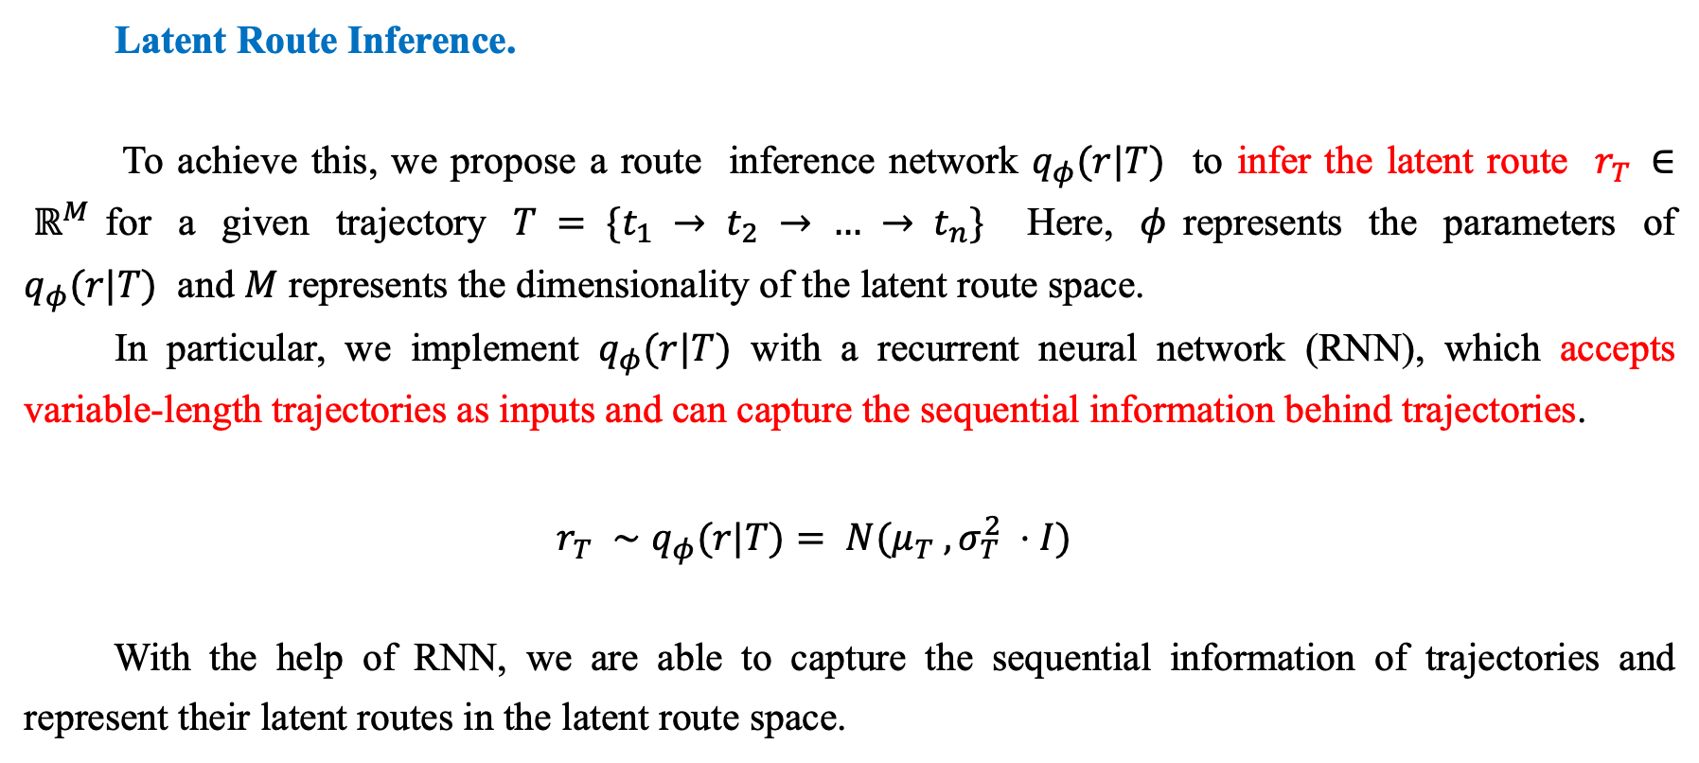
GMVSA
Latent Route Inference.
To achieve this, we propose a route inference network $q_{φ}(r|T)$ to infer the latent route $r_{T} ∈ ℝ^{M}$for a given trajectory $T = \{t_{1} → t_{2} → … → t_{n}\}$ Here, $φ$represents the parameters of $q_{φ}(r|T)$ and $M$ represents the dimensionality of the latent route space.
In particular, we implement $q_{φ}(r|T)$ with a recurrent neural network (RNN), which accepts variable-length trajectories as inputs and can capture the sequential information behind trajectories.
$$r_{T} ∼q_{φ}(r|T)= N(μ_{T} ,σ_{T}^{2} ⋅I)$$
With the help of RNN, we are able to capture the sequential information of trajectories and represent their latent routes in the latent route space.

Slide 9
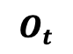

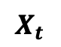
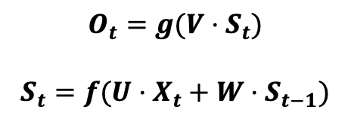

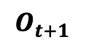
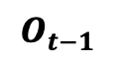
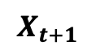
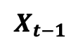
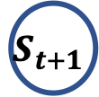
GMVSA
Latent Route Inference：RNN
A recurrent neural network (RNN) is a class of artificial neural networks where connections between nodes form a directed graph along a temporal sequence. This allows it to exhibit temporal dynamic behavior. Derived from feedforward neural networks, RNNs can use their internal state (memory) to process variable length sequences of inputs. This makes them applicable to tasks such as unsegmented, connected handwriting recognition or speech recognition.
$$O_{t}=g(V⋅S_{t})$$
$$S_{t}=f(U⋅X_{t}+W⋅S_{t−1})$$
O
$$O_{t−1}$$
$$O_{t}$$
$$O_{t+1}$$
V
V
W
W
W
W
S
$$S_{t−1}$$
$$S_{t}$$
$$S_{t+1}$$
W
U
U
U
X
U
$$X_{t−1}$$
$$X_{t}$$
$$X_{t+1}$$

Slide 10
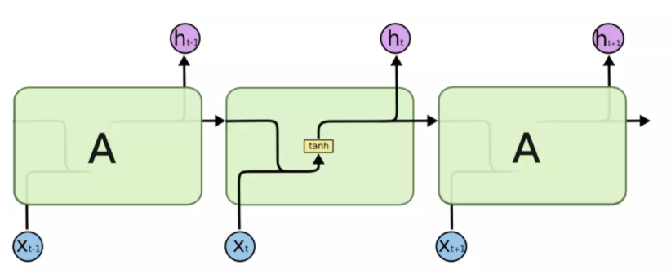
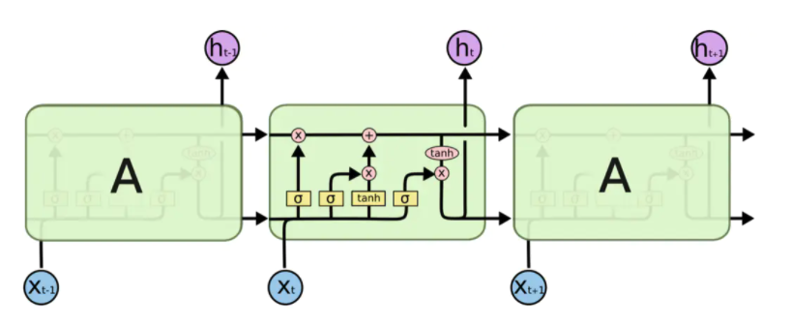
GMVSA
Latent Route Inference：LSTM
Long short-term memory (LSTM) is an artificial recurrent neural network (RNN) architecture[1] used in the field of deep learning. Unlike standard feedforward neural networks, LSTM has feedback connections. It can not only process single data points (such as images), but also entire sequences of data (such as speech or video).

Slide 11
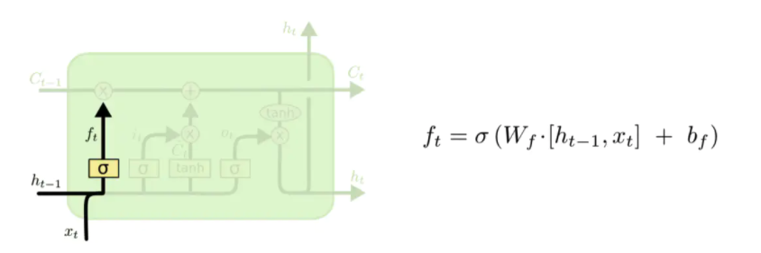
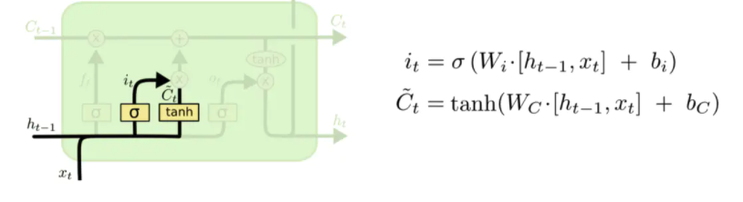
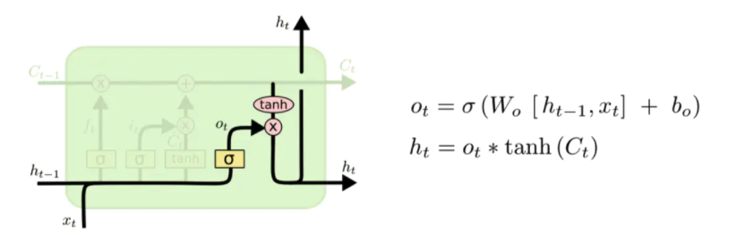
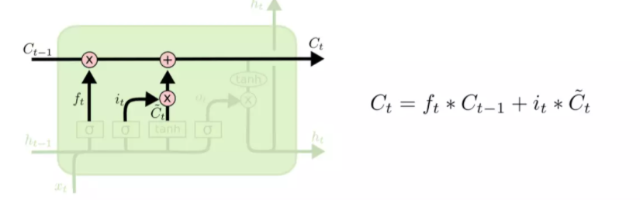
GMVSA
Latent Route Inference：LSTM - peephole connections.

Slide 12
GMVSA
Latent Route Inference：LSTM - peephole connections.

Slide 13
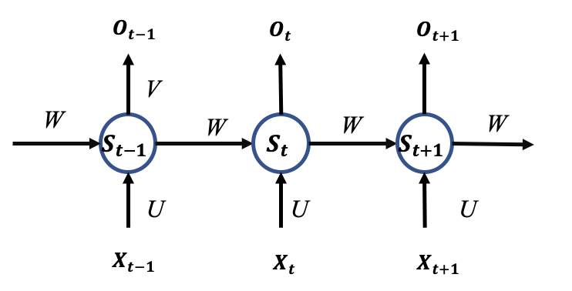
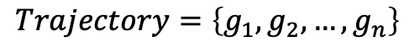
GMVSA
Latent Route Inference.
LSTM
Embedding
One-hot representation.
$$Trajectory=\left\{g_{1},g_{2},…,g_{n}\right\}$$

Slide 14
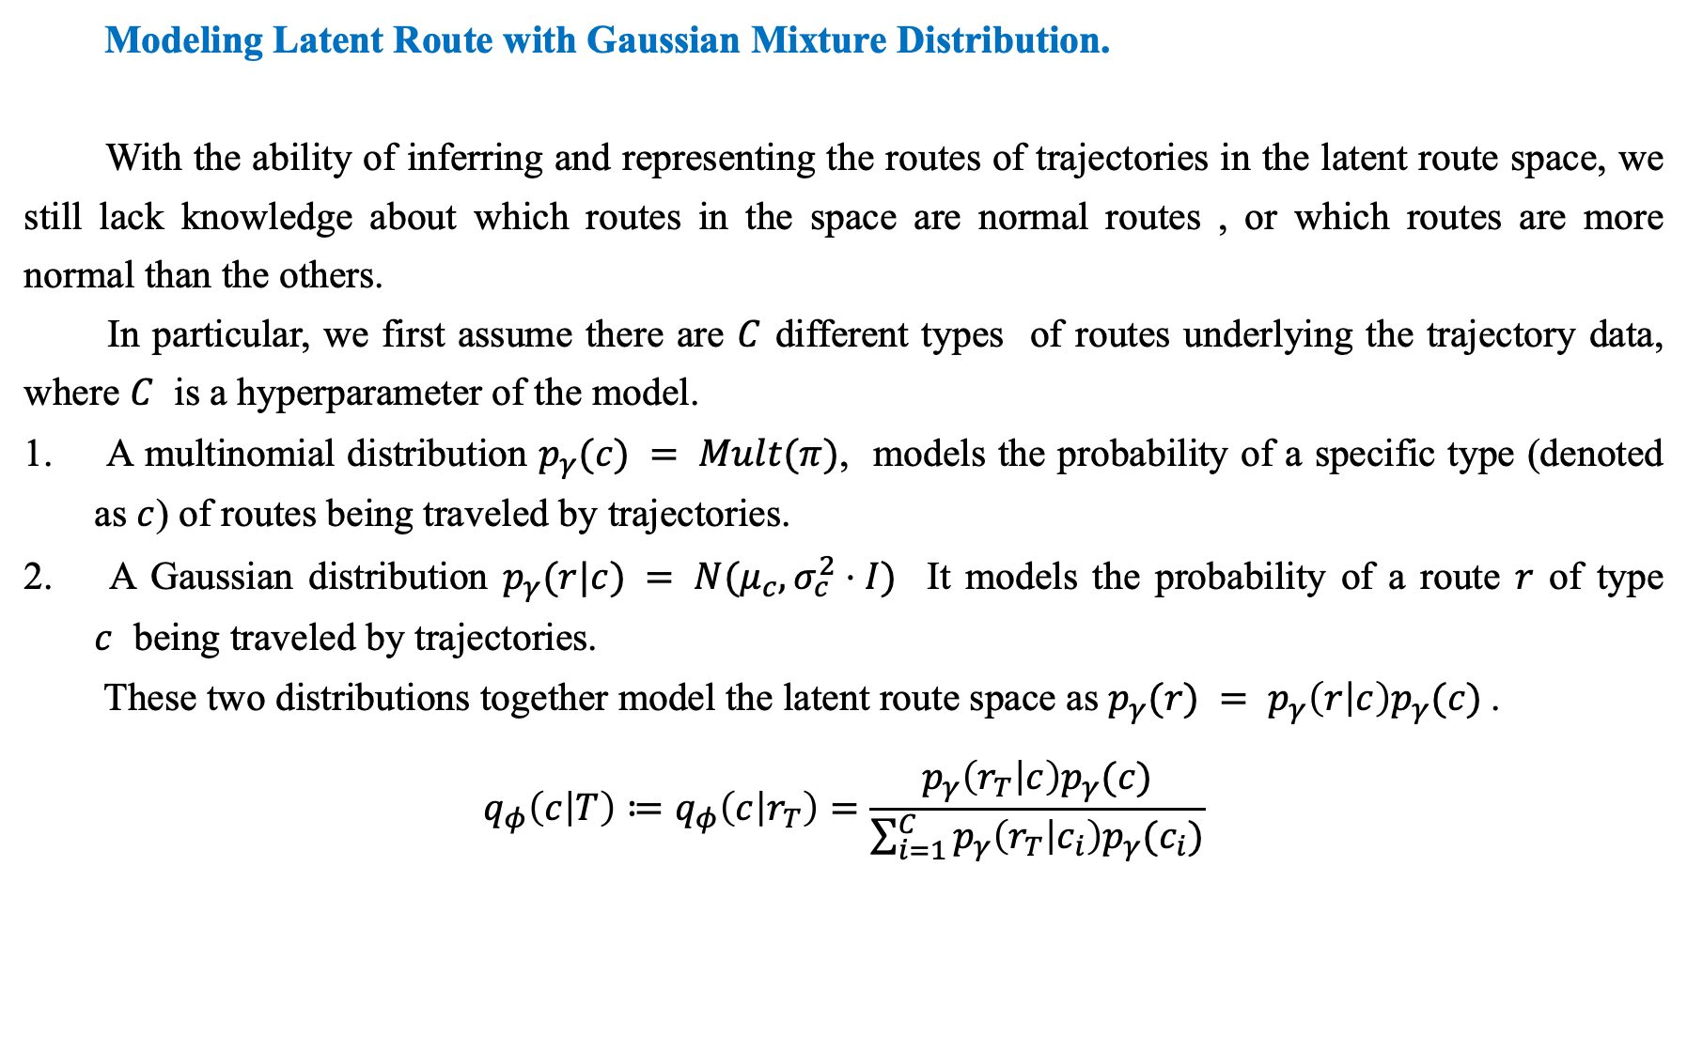
GMVSA
Modeling Latent Route with Gaussian Mixture Distribution.
With the ability of inferring and representing the routes of trajectories in the latent route space, we still lack knowledge about which routes in the space are normal routes , or which routes are more normal than the others.
In particular, we first assume there are $C$ different types of routes underlying the trajectory data, where $C$ is a hyperparameter of the model.
A multinomial distribution $p_{γ}(c) = Mult(π)$, models the probability of a specific type (denoted as $c$) of routes being traveled by trajectories.
A Gaussian distribution $p_{γ}(r|c) = N(μ_{c},σ_{c}^{2}⋅I)$ It models the probability of a route $r$ of type $c$ being traveled by trajectories.
These two distributions together model the latent route space as $p_{γ}(r) = p_{γ}\left(r | c\right)p_{γ}(c)$.
$$q_{φ}\left(c | T\right)≔q_{φ}\left(c | r_{T}\right)=\frac{p_{γ}\left(r_{T} | c\right)p_{γ}(c)}{\sum_{i=1}^{C}{p_{γ}\left(r_{T} | c_{i}\right)p_{γ}(c_{i})}}$$

Slide 15
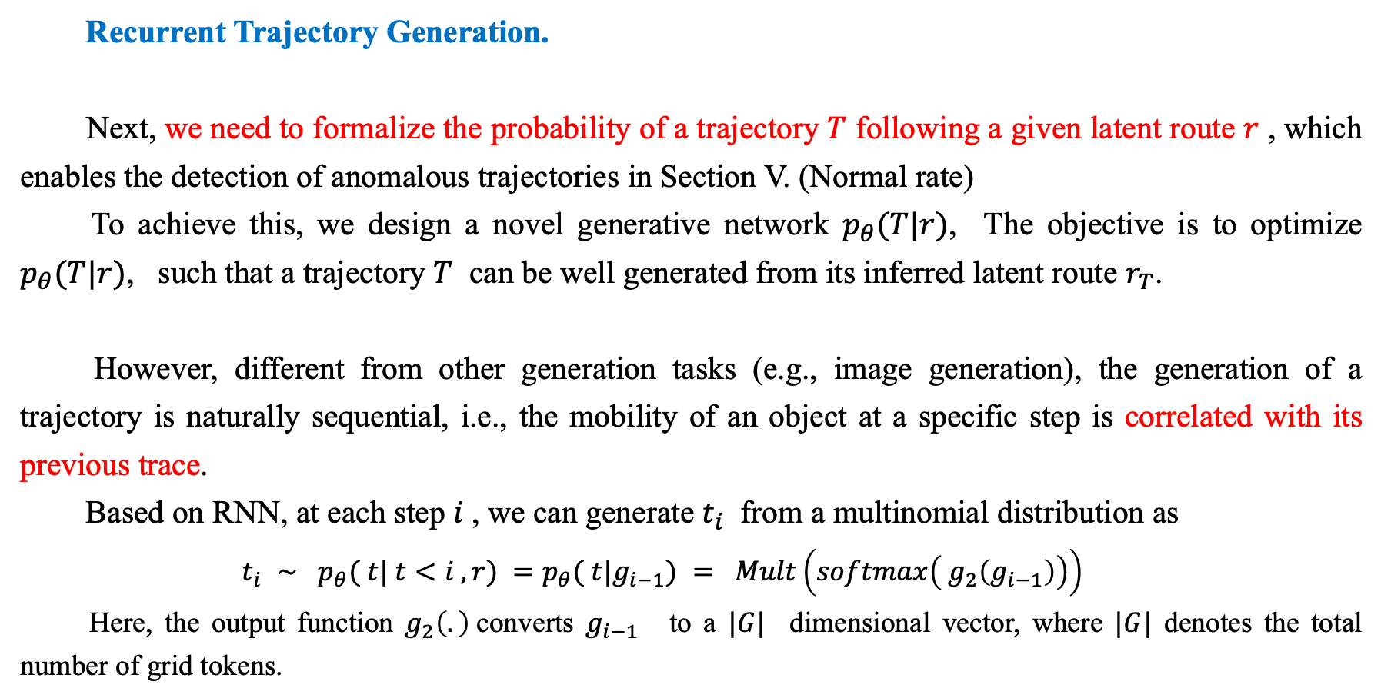
GMVSA
Recurrent Trajectory Generation.
Next, we need to formalize the probability of a trajectory $T$ following a given latent route $r$ , which enables the detection of anomalous trajectories in Section V. (Normal rate)
To achieve this, we design a novel generative network $p_{θ}(T|r)$, The objective is to optimize $p_{θ}(T|r)$, such that a trajectory $T$ can be well generated from its inferred latent route $r_{T}$.
However, different from other generation tasks (e.g., image generation), the generation of a trajectory is naturally sequential, i.e., the mobility of an object at a specific step is correlated with its previous trace.
Based on RNN, at each step $i$, we can generate $t_{i}$ from a multinomial distribution as
$$t_{i} ∼ p_{θ}( t| t<i , r) =p_{θ}( t|g_{i−1}) = Mult\left(softmax\left( g_{2}\left(g_{i−1}\right)\right)\right)$$
Here, the output function $g_{2}\left(.\right)$converts $g_{i−1}$ to a $|G|$ dimensional vector, where $|G|$ denotes the total number of grid tokens.

Slide 16
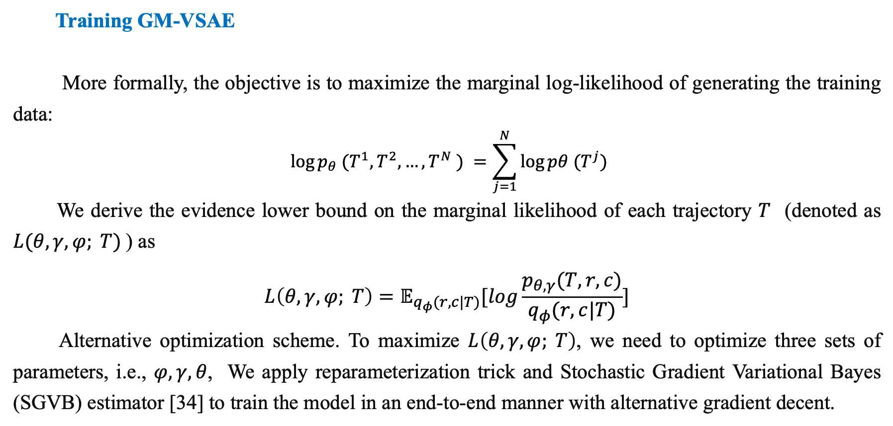
GMVSA
Training GM-VSAE
More formally, the objective is to maximize the marginal log-likelihood of generating the training data:
$$log⁡p_{θ} (T^{1}, T^{2}, …, T^{N} ) =\sum_{j=1}^{N}{log⁡pθ (T^{j})}$$
We derive the evidence lower bound on the marginal likelihood of each trajectory $T$ (denoted as $L(θ, γ, φ; T)$) as
$$L\left(θ, γ, φ; T\right)=𝔼_{q_{φ}(r,c|T)}[log\frac{p_{θ,γ}(T,r,c)}{q_{φ}(r,c|T)}]$$
Alternative optimization scheme. To maximize $L\left(θ, γ, φ; T\right)$, we need to optimize three sets of parameters, i.e., $φ, γ, θ$, We apply reparameterization trick and Stochastic Gradient Variational Bayes (SGVB) estimator [34] to train the model in an end-to-end manner with alternative gradient decent.

